Slide 1


Team Pandora
Spetrov.visualstudio.com
Winter Group – October 2013
Project “Lines and Boxes”

Slide 2
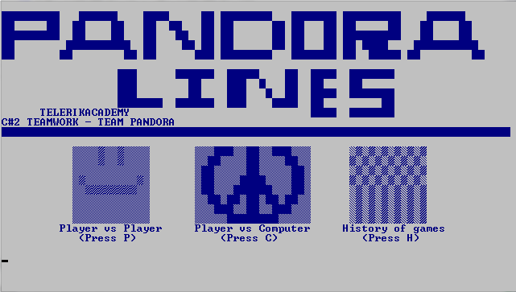
Team members…
Sergey Iliev
username: sergey.Illiev
Blagoi Dunchev
username: bldu88
Samuil Petrov
username: staccobain
Stefka Marinova
username: jibonata
Ivan Danchev
username: INavy
Krum Bagashev
username: skloser

Slide 3
Game Overview
The Game is Simple
2 Players, alternate turns drawing lines.
If one player makes a Square, he gets another turn.
The player with most completed squares at the end of the game wins.
History of the games is also included
Currently no AI is implemented.

Slide 4
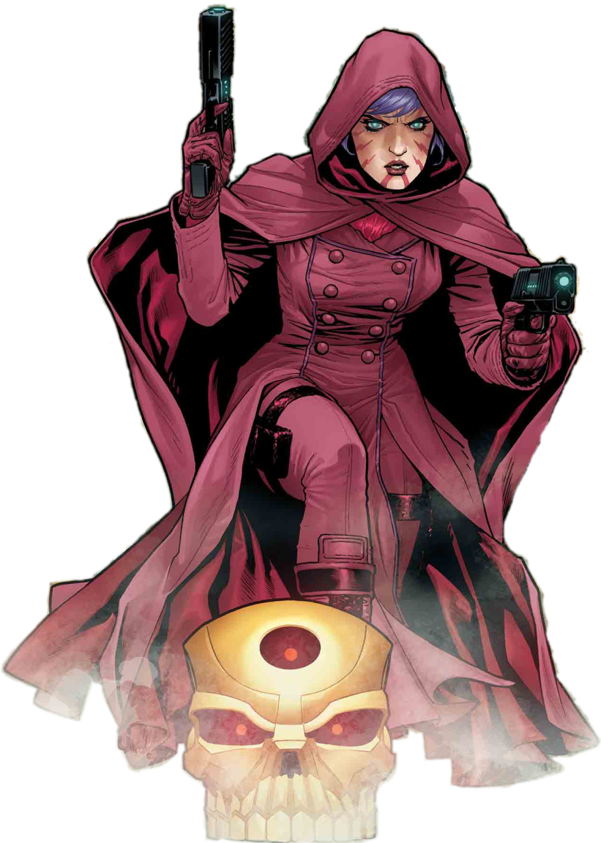
Lines and Boxes
Live Demo

Slide 5
Академия на Телерик
?
?
?
?
?
Въпроси?
?
?
?
?
?

